Slide 1
8.7: Systems of Inequalities
MATH 1550 - Precalculus

Slide 2
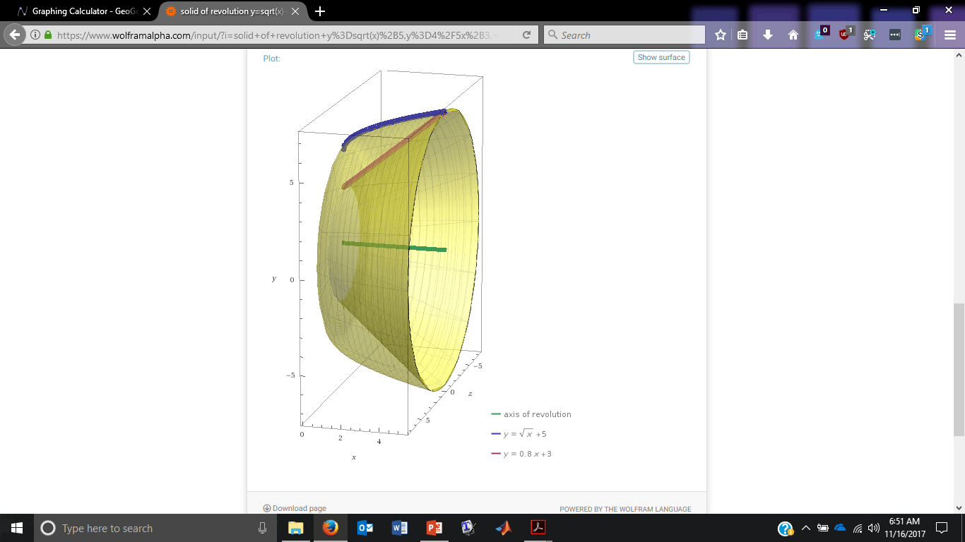
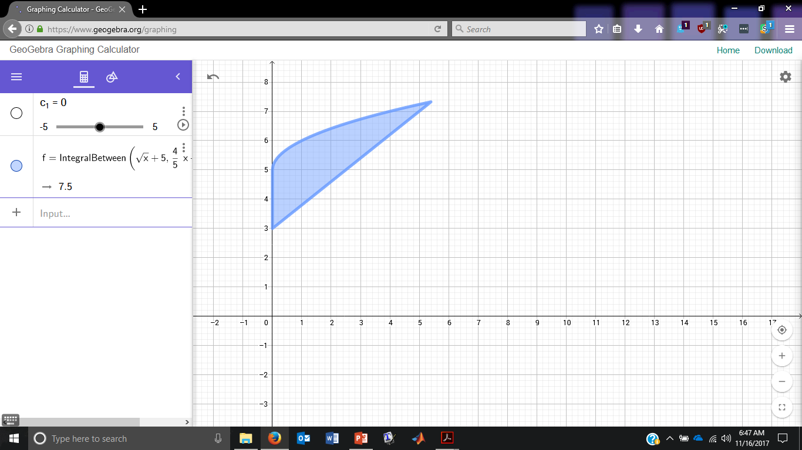

In Calculus II, you will be asked to:
Find the volume for the solid of revolution generated by revolving the region bounded by $\left\{\begin{aligned}y≤\sqrt{x}+5 \\ y≥\frac{4}{5}x+3 \\ x≥0\end{aligned}\right.$ about the $x$-axis.

Slide 3
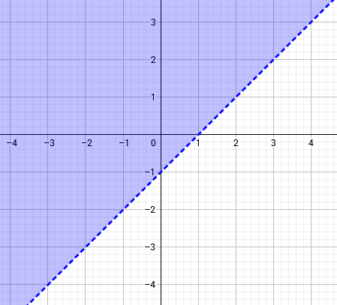
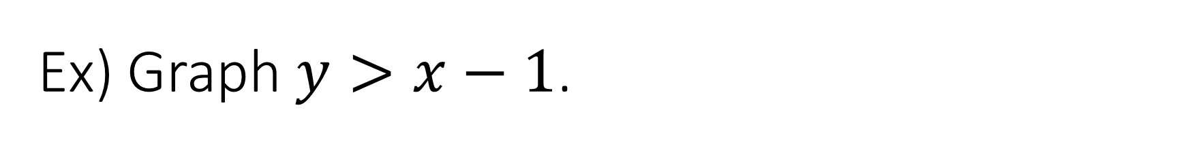
Ex) Graph $y>x−1$.

Slide 4
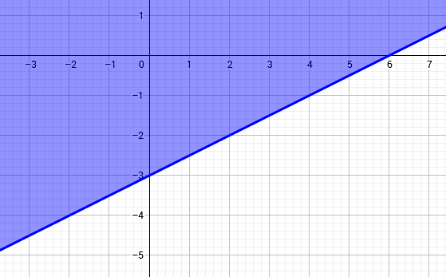
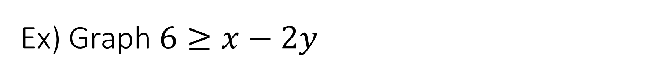
Ex) Graph $6≥x−2y$

Slide 5
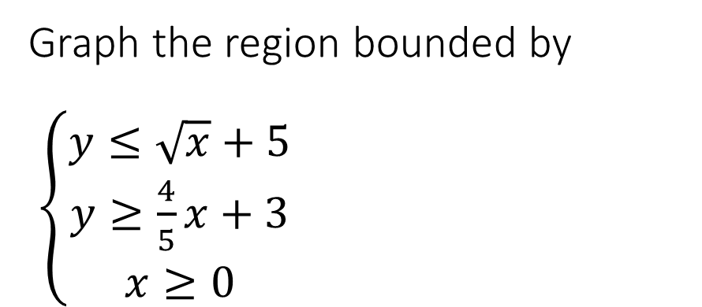
Graph the region bounded by $\left\{\begin{aligned}y≤\sqrt{x}+5 \\ y≥\frac{4}{5}x+3 \\ x≥0\end{aligned}\right.$

